Slide 1
Naive Bayes Classifier

Slide 2
Q: A given Dataset with 14 days of samples, and four attributes (Outlook, Temperature, Humidity, and Wind). The Target variable is Play Tennis with two possible outcomes one is Yes and other is No. Predict either player is Play Tennis (Yes or No), condition Outlook = Sunny, Temperature = Cool, Humidity = High, Wind = Strong)
Day | Outlook | Temperature | Humidity | Wind | Play Tennis
D1 | Sunny | Hot | High | Weak | No
D2 | Sunny | Hot | High | Strong | No
D3 | Overcast | Hot | High | Weak | Yes
D4 | Rain | Mild | High | Weak | Yes
D5 | Rain | Cool | Normal | Weak | Yes
D6 | Rain | Cool | Normal | Strong | No
D7 | Overcast | Cool | Normal | Strong | Yes
D8 | Sunny | Mild | High | Weak | No
D9 | Sunny | Cool | Normal | Weak | Yes
D10 | Rain | Mild | Normal | Weak | Yes
D11 | Sunny | Mild | Normal | Strong | Yes
D12 | Overcast | Mild | High | Strong | Yes
D13 | Overcast | Hot | Normal | Weak | Yes
D14 | Rain | Mild | High | Strong | NO

Slide 3
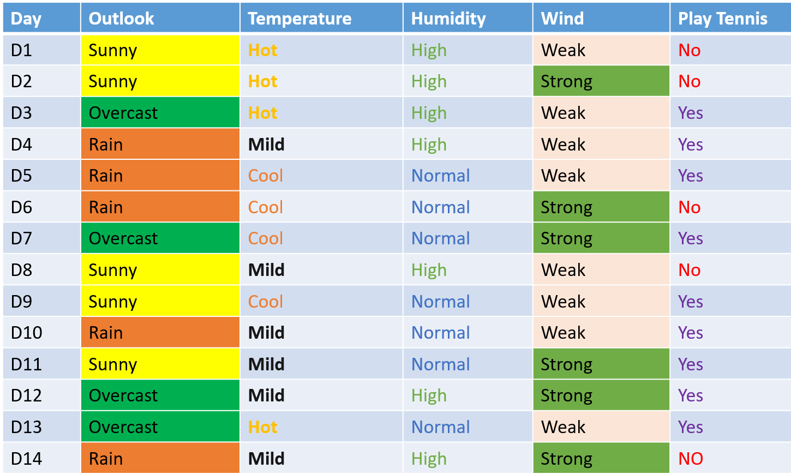
SOLUTION
$$Probability of Yes to Play Tennis=P\left(Play Tennis=Yes\right)=\frac{9}{14}=0.64$$
$$Probability of No to Play Tennis=P\left(Play Tennis=No\right)=\frac{5}{14}=0.36$$

Slide 4
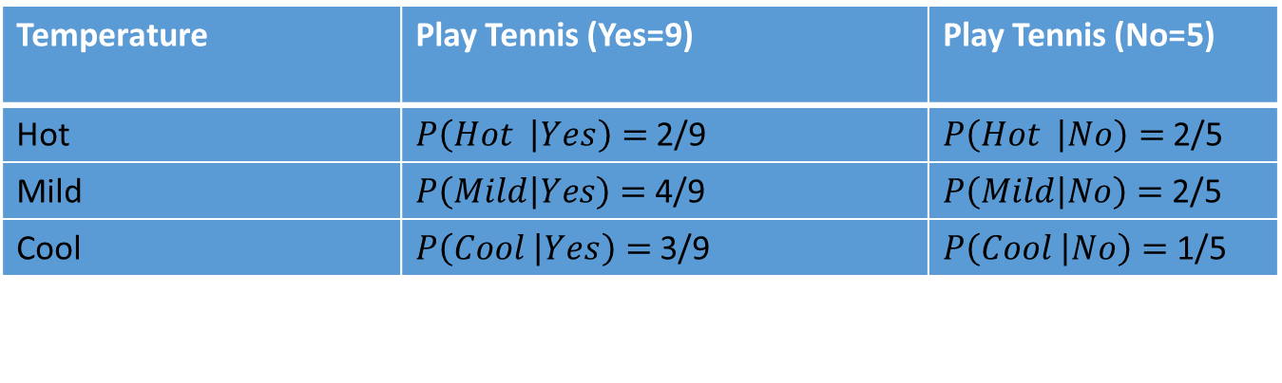
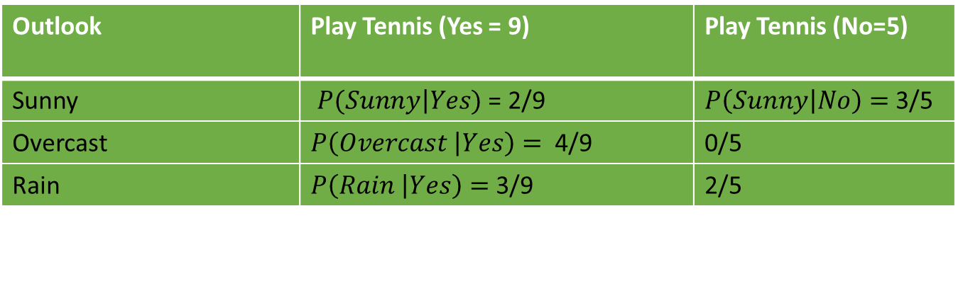
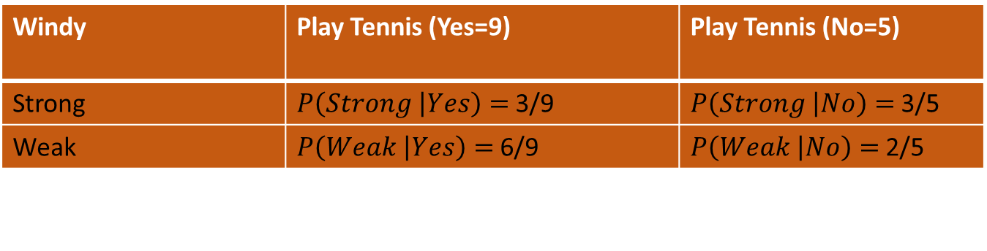
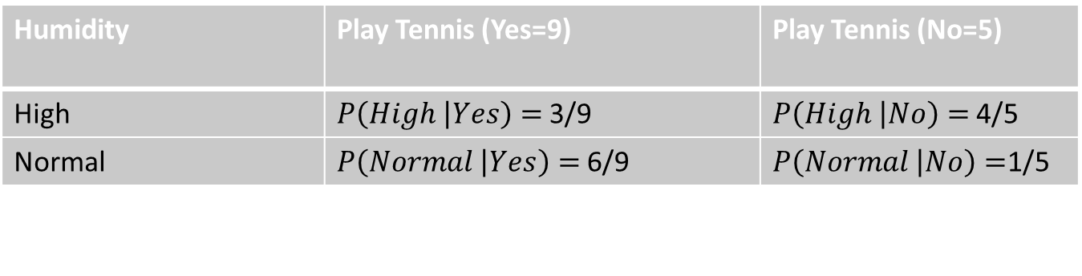
Outlook | Play Tennis (Yes = 9) | Play Tennis (No=5)
Sunny | $P(\left.Sunny\right|Yes)$ = 2/9 | $P\left(\left.Sunny\right|No\right)=$ 3/5
Overcast | $P\left(\left.Overcast \right|Yes\right)=$ 4/9 | 0/5
Rain | $P\left(\left.Rain \right|Yes\right)=$3/9 | 2/5
Temperature | Play Tennis (Yes=9) | Play Tennis (No=5)
Hot | $P\left(\left.Hot \right|Yes\right)=$2/9 | $P\left(\left.Hot \right|No\right)=$2/5
Mild | $P\left(\left.Mild\right|Yes\right)=$4/9 | $P\left(\left.Mild\right|No\right)=$2/5
Cool | $P\left(\left.Cool \right|Yes\right)=$3/9 | $P\left(\left.Cool \right|No\right)=$1/5
Humidity | Play Tennis (Yes=9) | Play Tennis (No=5)
High | $P\left(\left.High \right|Yes\right)=$3/9 | $P\left(\left.High \right|No\right)=$4/5
Normal | $P\left(\left.Normal \right|Yes\right)=$6/9 | $P\left(\left.Normal \right|No\right)=$1/5
Windy | Play Tennis (Yes=9) | Play Tennis (No=5)
Strong | $P\left(\left.Strong \right|Yes\right)=$3/9 | $P\left(\left.Strong \right|No\right)=$3/5
Weak | $P\left(\left.Weak \right|Yes\right)=$6/9 | $P\left(\left.Weak \right|No\right)=$2/5

Slide 5
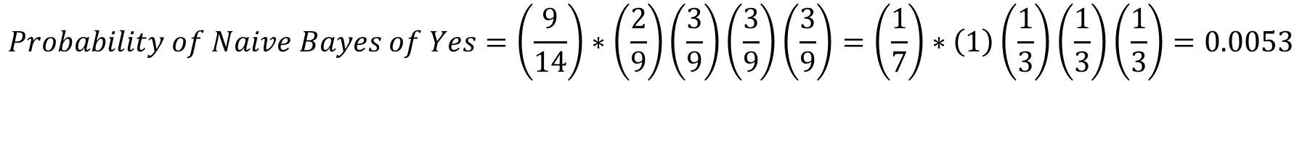
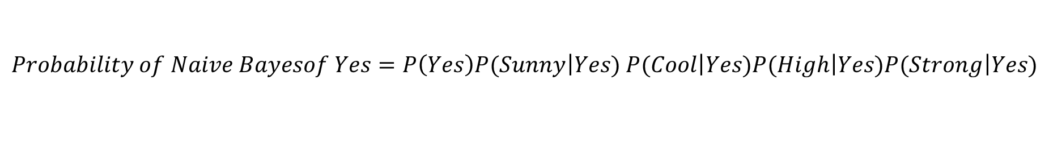
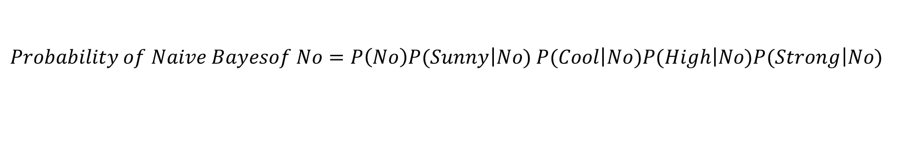
$Probability of Naive Bayesof Yes=P\left(Yes\right)P(\left.Sunny\right|Yes)$ $P(\left.Cool\right|Yes)P(\left.High\right|Yes)P(\left.Strong\right|Yes)$
$$Probability of Naive Bayes of Yes=\left(\frac{9}{14}\right)∗\left(\frac{2}{9}\right)\left(\frac{3}{9}\right)\left(\frac{3}{9}\right)\left(\frac{3}{9}\right)=\left(\frac{1}{7}\right)∗\left(1\right)\left(\frac{1}{3}\right)\left(\frac{1}{3}\right)\left(\frac{1}{3}\right)=0.0053$$
$Probability of Naive Bayesof No=P\left(No\right)P(\left.Sunny\right|No)$ $P(\left.Cool\right|No)P(\left.High\right|No)P(\left.Strong\right|No)$
$$Probability of Naive Bayes of No=\left(\frac{5}{14}\right)∗\left(\frac{3}{5}\right)\left(\frac{1}{5}\right)\left(\frac{4}{5}\right)\left(\frac{3}{5}\right)=\left(\frac{3}{14}\right)\left(\frac{1}{5}\right)\left(\frac{4}{5}\right)\left(\frac{3}{5}\right)=\frac{24}{1050}=0.02$$
Compare both Probability , so No have more probability. It means not Playing Tennis ………………Answer
Suppose I want to Verify Seventh Day is it Yes, so apply Naïve Bayes formula
D7 condition is Outlook = Overcast, Temperature = Cool, Humidity = Normal, Wind = Strong)

Slide 6
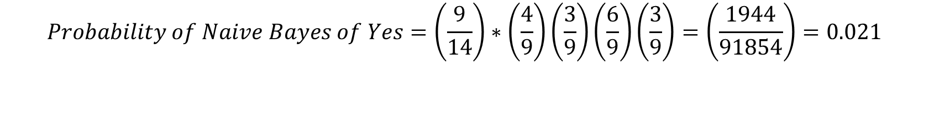
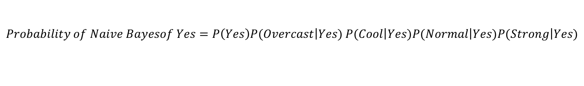
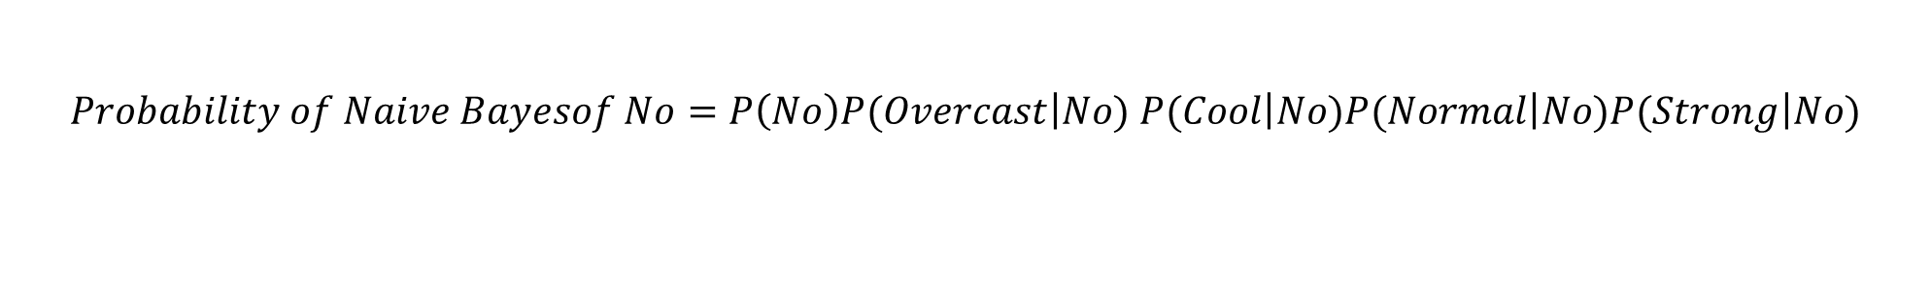
$Probability of Naive Bayesof Yes=P\left(Yes\right)P(\left.Overcast\right|Yes)$ $P(\left.Cool\right|Yes)P(\left.Normal\right|Yes)P(\left.Strong\right|Yes)$
$$Probability of Naive Bayes of Yes=\left(\frac{9}{14}\right)∗\left(\frac{4}{9}\right)\left(\frac{3}{9}\right)\left(\frac{6}{9}\right)\left(\frac{3}{9}\right)=\left(\frac{1944}{91854}\right)=0.021$$
$$Probability of Naive Bayesof No=P\left(No\right)P(\left.Overcast\right|No) P(\left.Cool\right|No)P(\left.Normal\right|No)P(\left.Strong\right|No)$$
$$Probability of Naive Bayes of No=\left(\frac{5}{14}\right)∗\left(0\right)\left(\frac{1}{5}\right)\left(\frac{4}{5}\right)\left(\frac{3}{5}\right)=\left(\frac{3}{14}\right)\left(\frac{1}{5}\right)\left(\frac{1}{5}\right)\left(\frac{3}{5}\right)=0$$
Compare both Probability , so Yes have more probability. It means Playing Tennis ………………Answer

